Slide 1


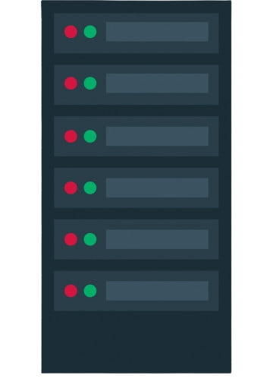
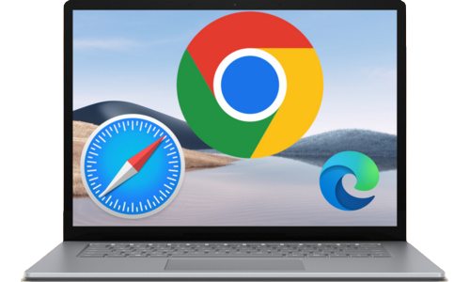
How Do the Website Work ?
Server returns response in the form of ( HTML, CSS, JavaScript )
Search on Browser
https://www.chaicode.com
User
https://www.chaicode.com
Users request to find a website from the server through the browser
172.67.213.172
Web Server
Browser
172.67.213.172
DNS Server

